Slide 1
Registration Form
Ajay v g

Slide 2
Introduction
In the digital age, user registration forms play a crucial role in various applications, ranging from social media platforms to online shopping websites. These forms provide a means for users to establish a unique identity within the system, granting them access to personalized features and secure interactions.The purpose of this project is to create as simple registration form.

Slide 3
Project Objectives
1.Understand User Registration: Derive into the significance of user registration and its relevance in modern applications.
2.Collect User Information: Explore the collection of essential user data such as full name, age, email address, username,password and gender.
3.Basic Data Validation: Implement simple validation techniques to ensure that the entered data follows the expected format and constraints.
4.Display Confirmation: Provide users with immediate feedback by displaying the entered information upon successful registration.

Slide 4
User Registration Form Requirements:
Full Name:
Validate for non-empty input.
Ensure proper capitalization and formatting.
Age:
Validate for numeric input.
Ensure the user is within an acceptable age range.
Username:
Validate for non-empty input.
Check for uniqueness to prevent duplicate username

Slide 5
Password Security:
Encourage users to create strong passwords with a mix of uppercase and lowercase letters, numbers, and special characters.
Implement password strength validation to guide users in creating secure passwords.
Gender
Consider adding a field for individuals to specify their gender pronouns (e.g., he/him, she/her, they/them). This demonstrates respect for individuals' chosen pronouns.

Slide 6
Implementation

Slide 7
1. Initialization and Welcome Message: The project begins with a welcome message displayed to the user. This message informs the user about the purpose of the program and guides them through the registration process.
2. User Input: The user is prompted to input the following details:
Name: The user's full name.
Age: The user's age.
Gender: The user's gender.
Username: A chosen username for registration.
Password: A chosen password.
Confirm Password: The user re-enters the password for confirmation

Slide 8
3. Password Validation: The script checks whether the entered password matches the confirmed password. If the passwords do not match, an error message is displayed, indicating that the registration has failed due to password mismatch.
4. Registration Success/Failure: If the passwords match, the script displays a success message, indicating that the registration was successful. If the passwords do not match, the script displays a failure message, alerting the user that the registration process has failed

Slide 9
Out put

Slide 10
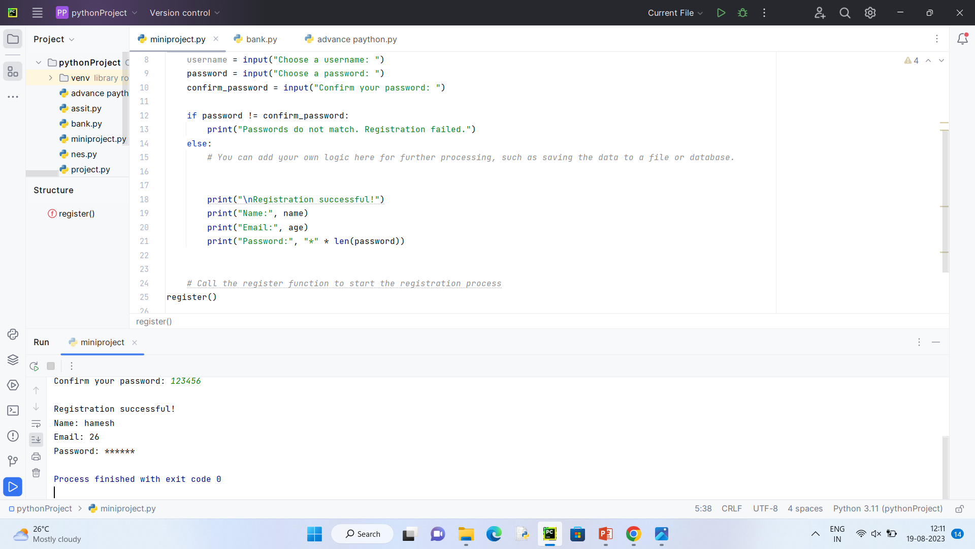

Slide 11
Benefits:
Quick and straightforward registration process.
No dependency on external graphical libraries.
Limitations:
Lack of user-friendliness compared to GUI-based registration forms.
Limited error handling and validation in this basic implementation.

Slide 12
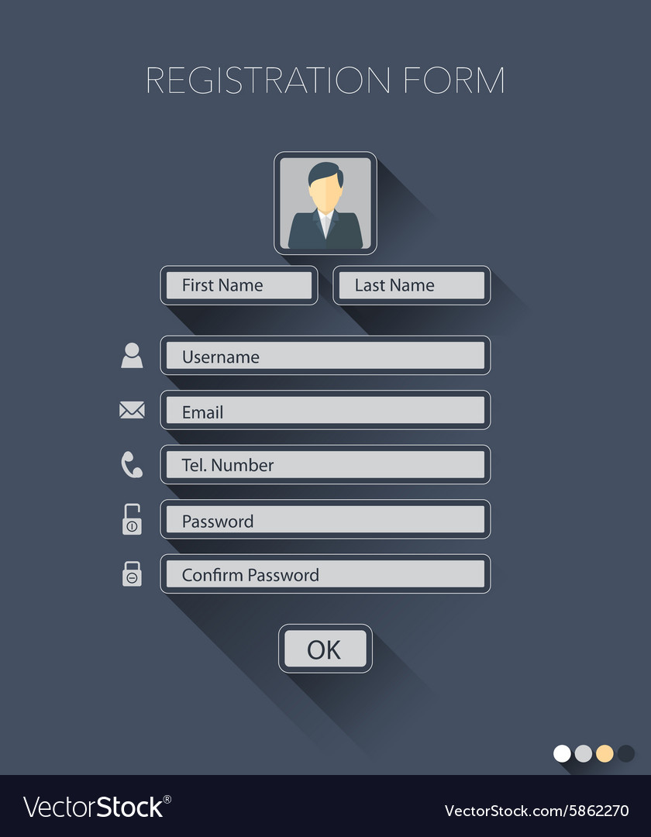
The experiment

Slide 13
Improvements
Implement password hashing for security.
Store registration data in a database.
Enhance user experience with better validation and error messages.

Slide 14
Conclusion:
This project demonstrates how to create a basic text-based registration form in Python. While it lacks the visual appeal of GUI-based forms, it serves as an introduction to user input and validation concepts.
The project can be expanded and improved to meet more advanced requirements in future applications.

Slide 15
Thank you

